Slide 1

Advanced
Css

Slide 2

QA

Slide 3

Improve your CSS skill

Slide 4
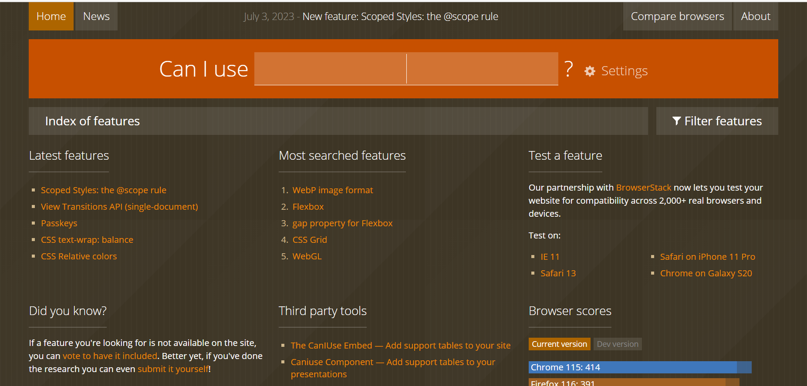
Availability
Can I use... Support tables for HTML5, CSS3, etc

Slide 5
best practice
How to code better?

Slide 6
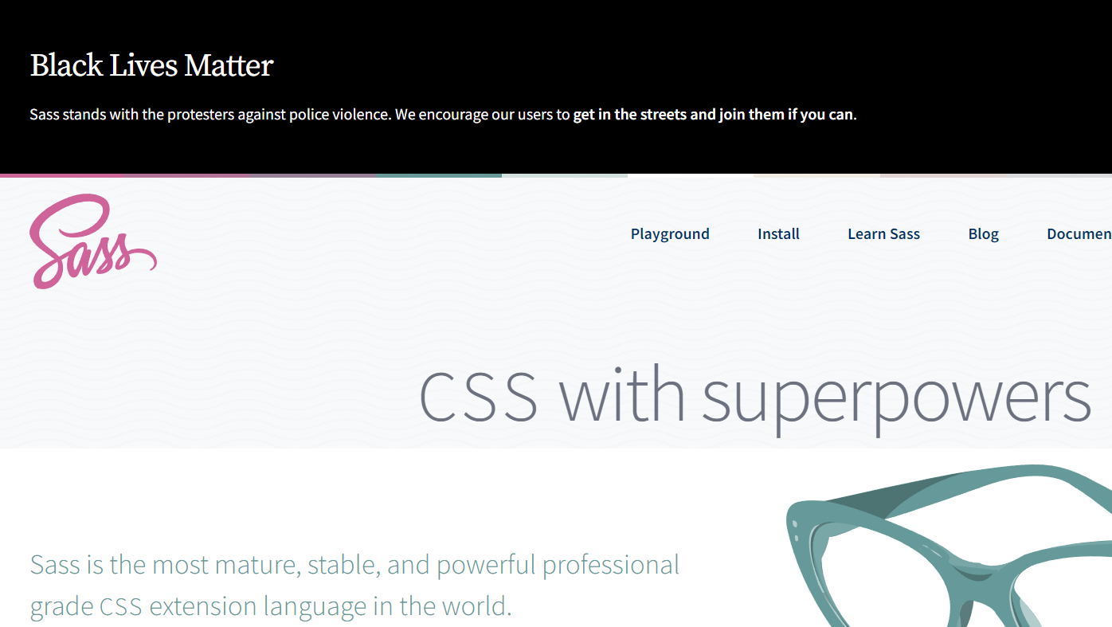
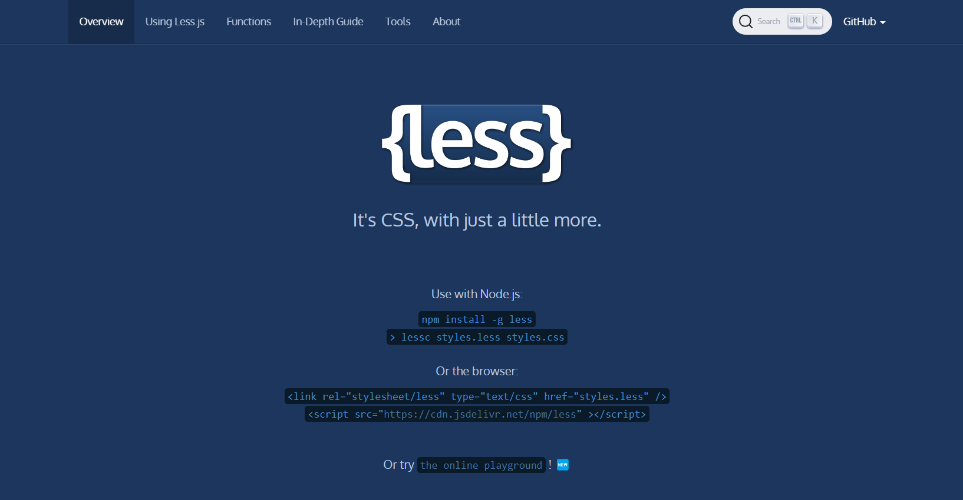
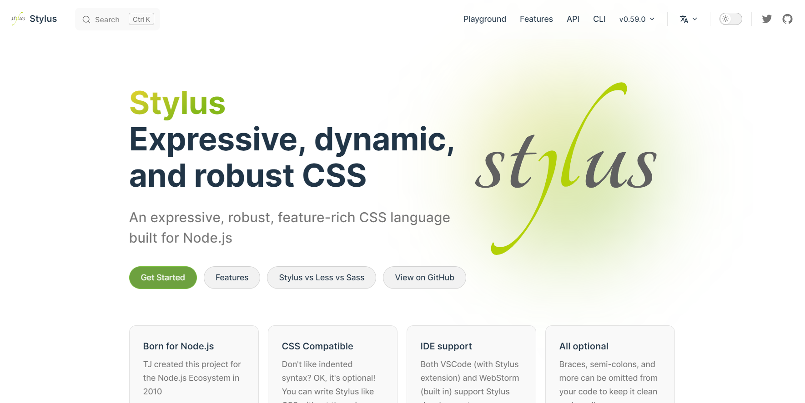
Preprocessors
SASS
Less
Stylus

Slide 7
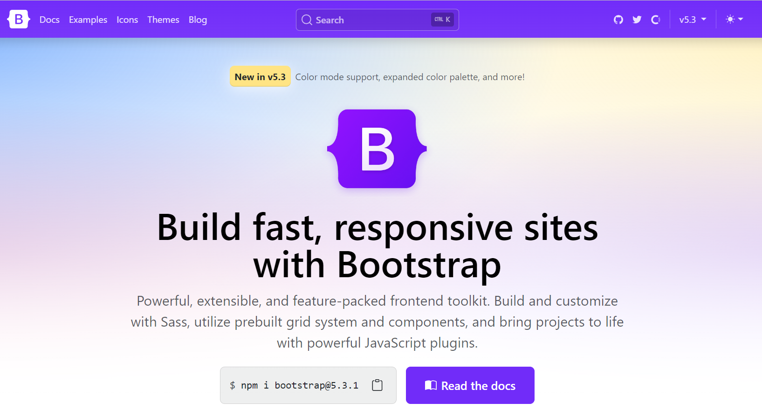

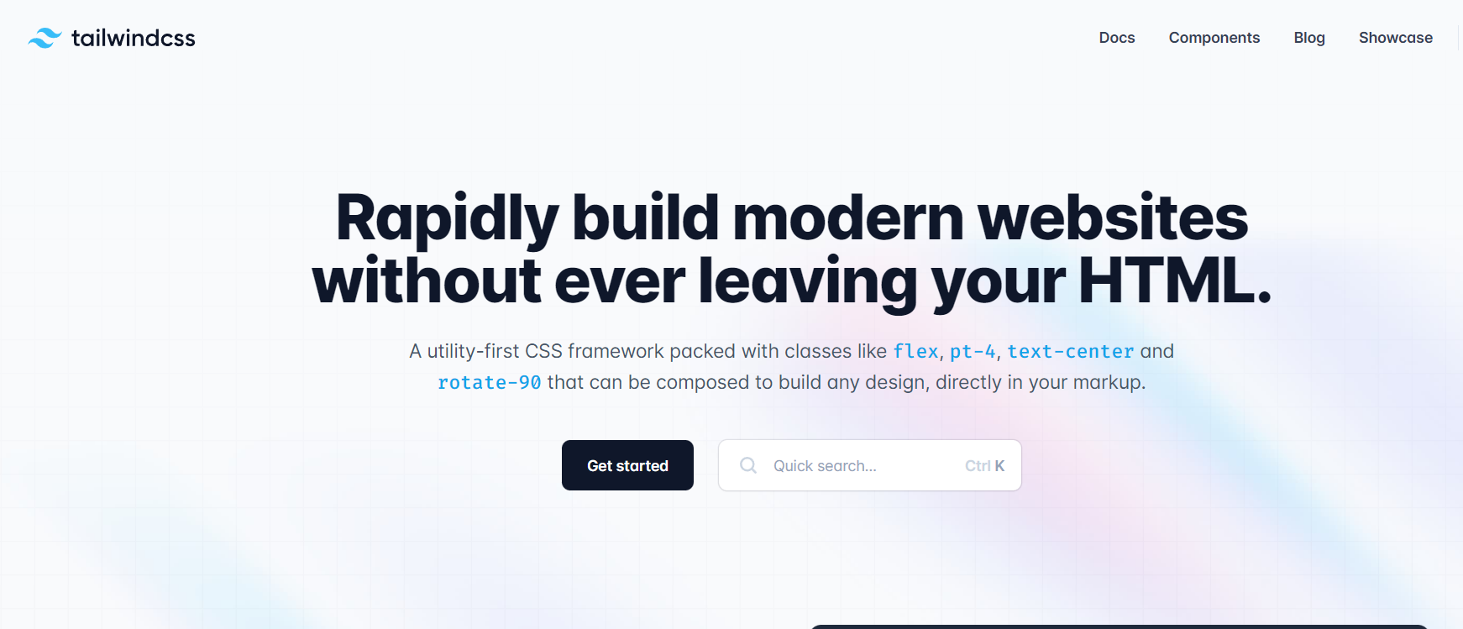
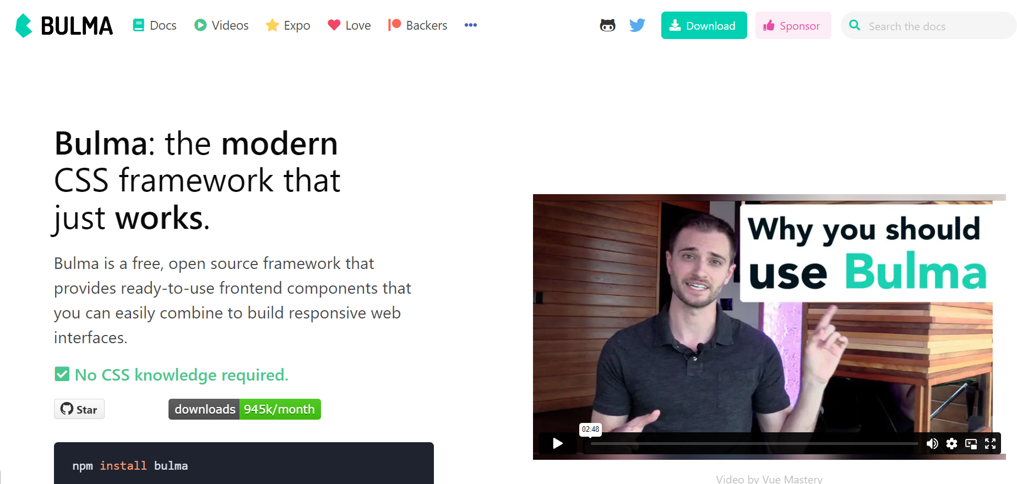
CSS frameworks
Bootstrap
Foundation
Tailwind
Bulma

Slide 8
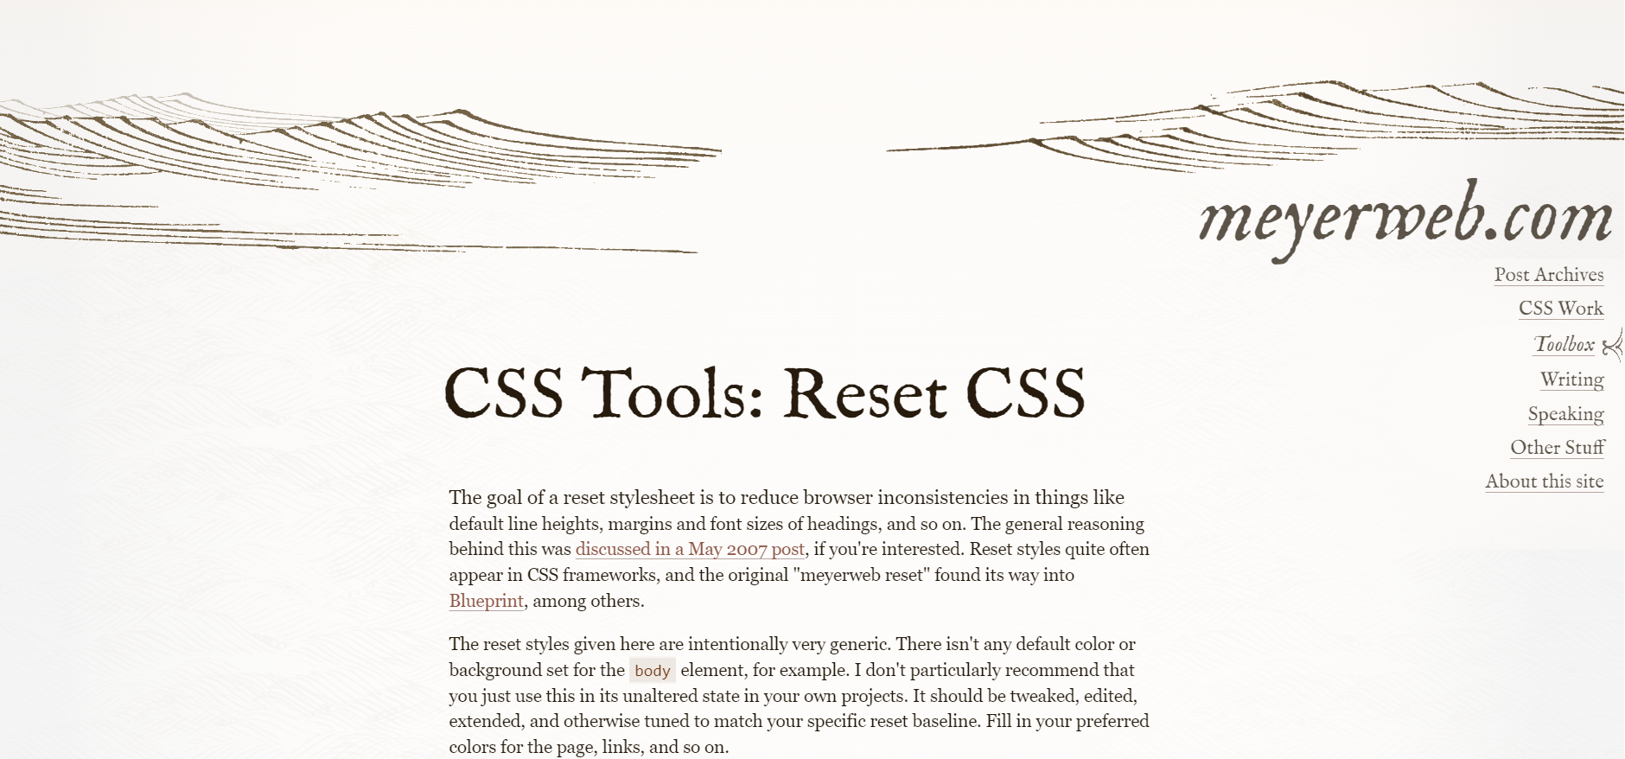
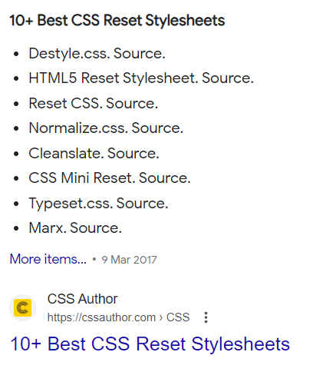
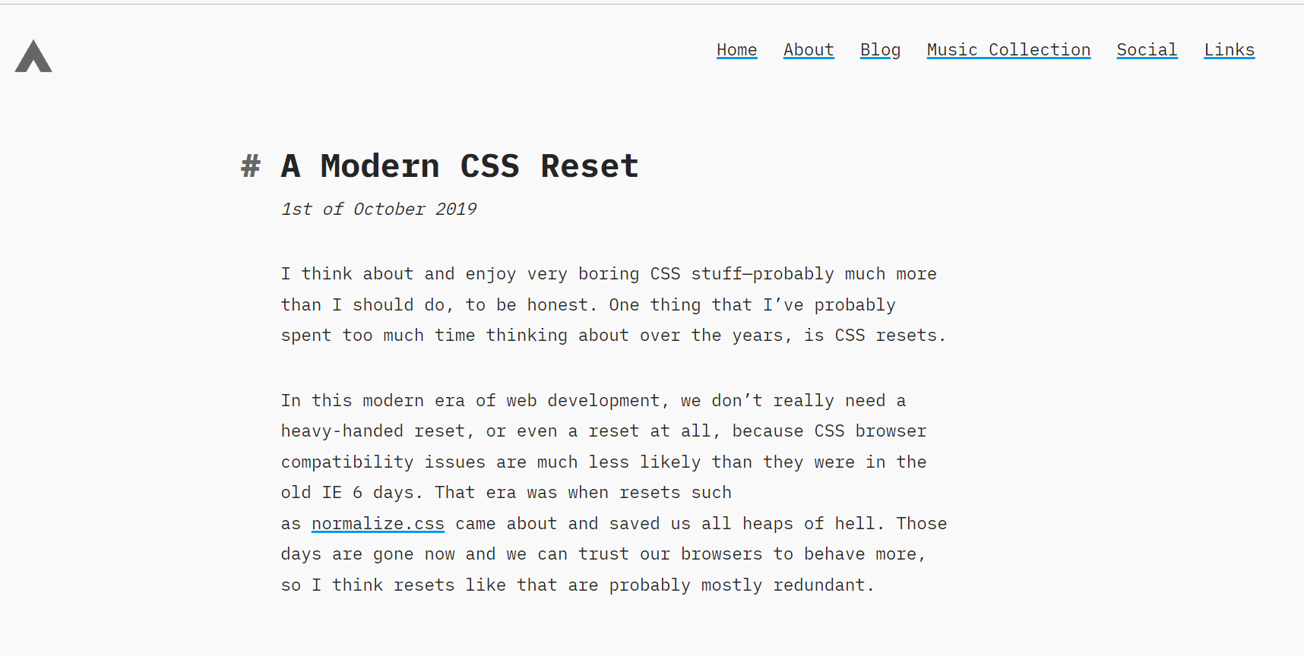
Reset CSS

Slide 9
Classes vs id’s
DRY !!!!
Combine selectors
Remove extra selectors
Beginner Concepts: How CSS Selectors Work | CSS-Tricks - CSS-Tricks

Slide 10
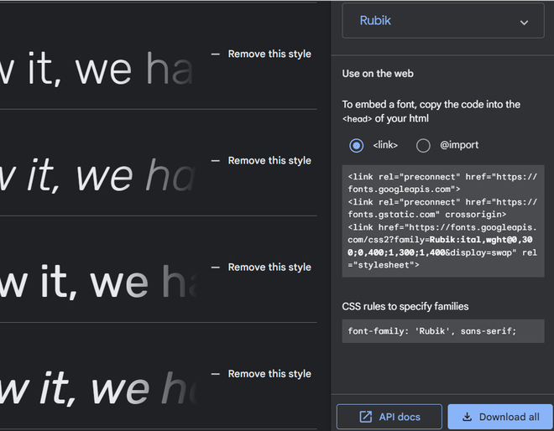
Import font
Browse Fonts - Google Fonts

Slide 11
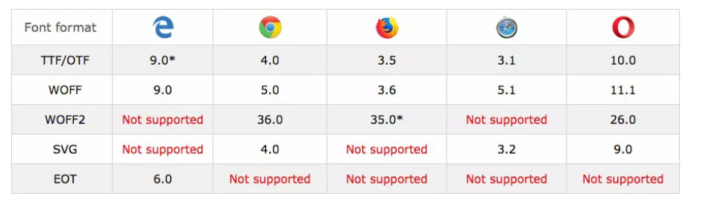
Why ttF?

Slide 12
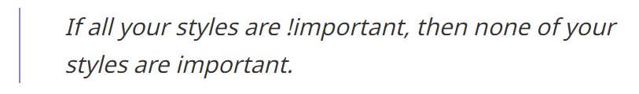
No !important
CSS !important: Don't Use It. Do This Instead – UX Engineer

Slide 13
Font-size: $$$
Why the browser's default font size is 16px?

Slide 14
Font-size: 62.5%
What does happen when we set font size : 10px?

Slide 15
Font-size: 62.5%
Why not 6.25%?
The 62.5% Font Size Trick | Aleksandr Hovhannisyan

Slide 16

CSS with superpowers

Slide 17
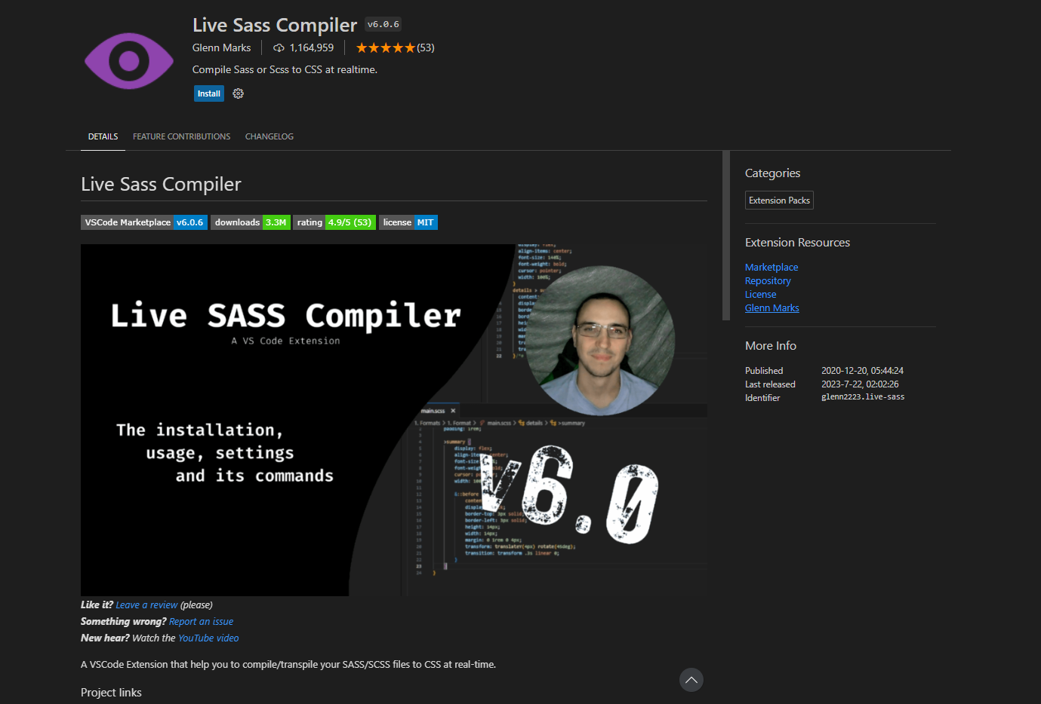
One of the ways…

Slide 18
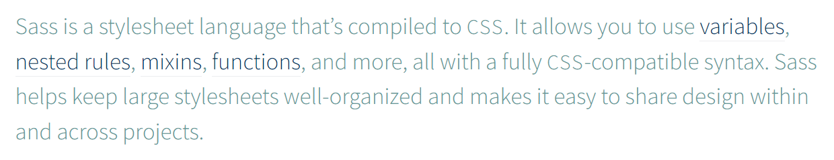
SASS
SCSS
SASS in CSS!
Sass: Documentation (sass-lang.com)

Slide 19
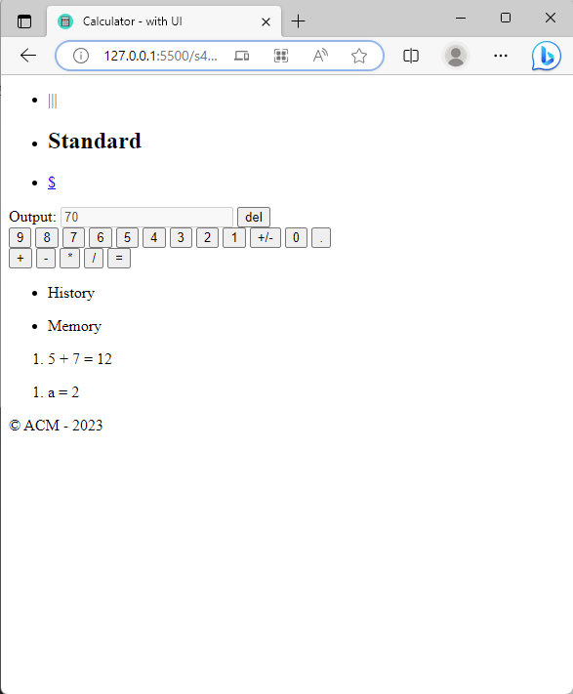
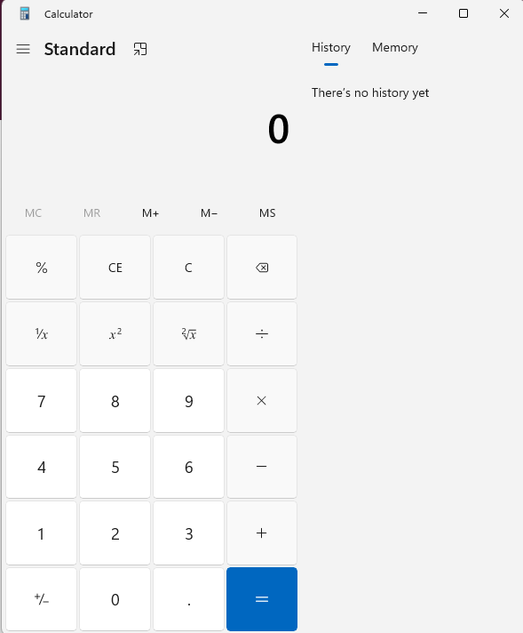
Let’s practice SASS!

Slide 20
